Slide 1
Ahhh! Get these monsters out of my castle!
Teddy, Anna, Arnold, Byeongchan

Slide 2
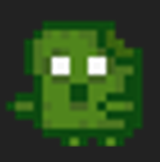
Our Game
2D Top down survival
Player controls an adventurer defending home from monsters
3 levels of increasing difficulty, upgrade after each level
Final level ends when the final boss is defeated

Slide 3
Our Feedback Loop
Input - Keyboard (WASD+Space) and Mouse
Action - Shoot projectile and Run
Obstacle - Enemies coming at you, Pits and Spikes to avoid
Goal - Remove all enemies on screen to progress to next level.

Slide 4
Playtest
https://byeongchan.itch.io/vg1-teddyteamfinal-0420

Slide 5
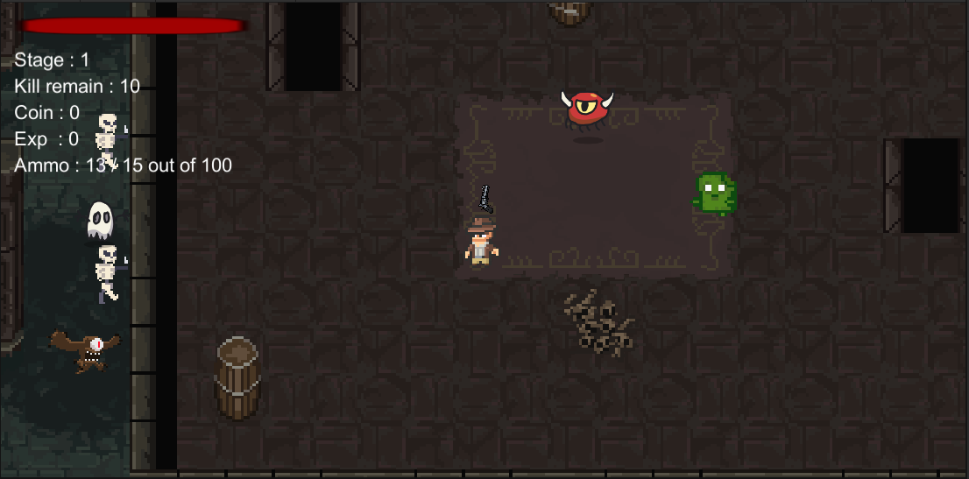
Our Approach
Weekly meetings
Fill out progress report, discuss bugs, divide future tasks
Divide and Conquer

Slide 6
Positives and Negatives
Positives:
Everyone knew what they were responsible for
Progress made each week
Everyone was knowledgeable about the whole project
Negatives:
Merging together often caused errors/merge conflicts
Hard to know how far along others are
Changing things without proper knowledge

Slide 7
Recommendations
Weekly group meetings
Group chat/constant communication
Get as many playtesters as possible (and a variety of playtesters)

Slide 8
Successes and Failures
Successes:
Core game idea achieved
Playtesters like the overall style and experience
Wide array of animations for player and monsters
Replayability
Failures:
Implementing multiple weapons
Melee weapon
Switching weapons
Special bullets for bosses

Slide 9
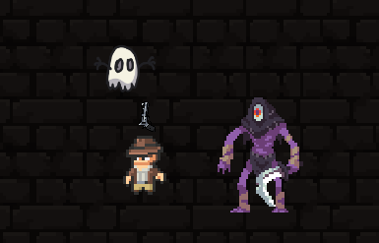
Lessons Learned
First large scope group project
Be flexible and realistic
Communication
Weekly progress > Crunch

Slide 10
Citation
https://henrysoftware.itch.io/pixel-food
https://clembod.itch.io/bringer-of-death-free
https://elthen.itch.io/2d-pixel-art-archaeologist
https://www.pixilart.com/art/pixel-bullet-00e5a8660c772f2
https://flyclipart.com/ammo-pixel-art-maker-ammo-png-501329
https://munstudios.itch.io/2d-pixel-guns-pack
https://assetstore.unity.com/packages/2d/environments/rogue-fantasy-castle-164725
https://assetstore.unity.com/packages/2d/characters/monsters-creatures-fantasy-167949
https://www.shutterstock.com/image-illustration/2d-brick-wall-texture-moss-assets-2068449416

